Slide 1
Field of Interest
19SW42

Slide 2
My Introduction
Hello there!
I am Zohaib Hassan: A Flutter developer, Java developer, Beta MLSA, and former CTO at Evolvve. I have 2+ years of experience in programming in different languages.
I have also been awarded certificates in C++/HTML/Java/App Development by Solo Learn, Microsoft & Huawei. Recently I have developed some apps using FLUTTER(Dart) technology, including the Weather app, Calculator, Music Apps, etc. Currently I am learning about computer networking and I am also improving my problem solving skills.
Let’s connect on LinkedIn:(23) Zohaib Hassan | LinkedIn

Slide 3
Current field of interest
I am interested in improving problem-solving skills in programming. This means finding ways to become better at identifying and fixing problems in code. Problem-solving skills are essential for any programmer as they help to overcome challenges and create efficient solutions. By improving my problem-solving skills, I can become a better programmer and deliver high-quality code that meets the needs of my clients or customers. I am actively seeking out resources and techniques to enhance my problem-solving abilities in programming.

Slide 4
How I got there?
I became interested in problem-solving when I learned that it's a skill commonly required during job interviews, even at a company like Google. I realized that being able to solve problems efficiently and effectively is important in many areas of computer technology. So, I decided to work on improving my problem-solving abilities by practicing and seeking out resources that could help me develop this skill.

Slide 5
What seems fascinating in problem solving?
I find it enjoyable to use coding to solve real-world problems. As a daily activity, I typically complete three to four problem-solving questions. It is a fun and rewarding way for me to apply my coding skills in a practical manner. By tackling real-world challenges, I am able to enhance my problem-solving abilities and continually learn and grow as a programmer.

Slide 6
what are your current achievements,
I have earned certifications in both basic and intermediate problem-solving tests on Hackerrank. These certifications demonstrate my ability to effectively solve problems using coding and provide validation of my skills in this area. By completing these tests, I am proud to have obtained these certifications and look forward to further developing my coding abilities through continued practice and learning.

Slide 7
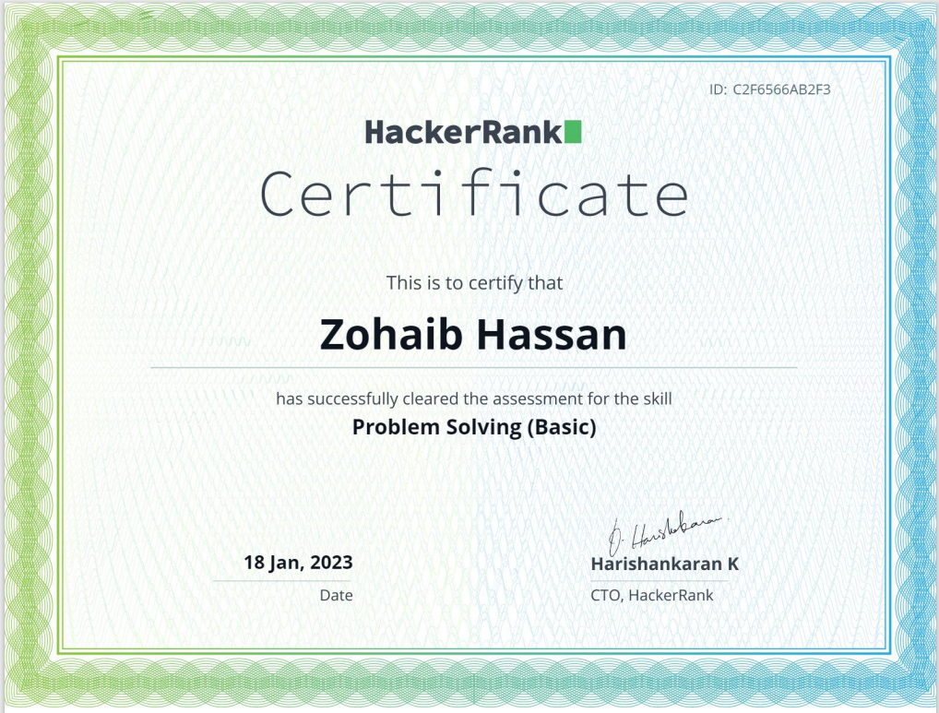
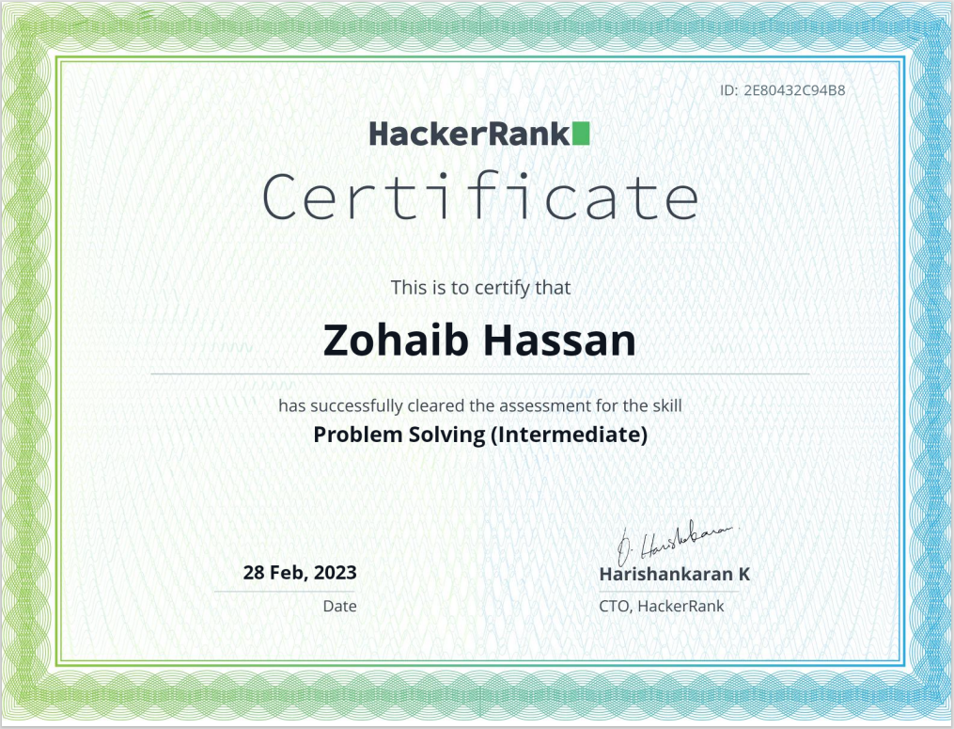
Some screenshots

Slide 8
Why you have chosen that field?
I am preparing for potential job interviews in the tech field, which is why I am dedicating time to practicing problem-solving and coding. By regularly practicing and improving my skills, I can confidently showcase my abilities during interviews and demonstrate my passion and dedication to the field. Overall, my focus on problem-solving and coding practice is driven by my desire to excel in the tech industry and secure a fulfilling career.

Slide 9
what pathways you followed and how would you guide others if someone wants to pursue it. ?
I signed up on Hackerrank to improve my problem-solving skills. It provides practice questions and a certification system that tests and validates coding abilities. The questions simulate real-world problems and are suitable for coders of all skill levels. It is a valuable tool for preparing for job interviews and achieving career goals in the tech industry.

Slide 10
About field
Problem-solving skills refer to the ability to identify, analyse, and solve complex problems using critical thinking, creativity, and logical reasoning. Effective problem solvers break down problems, develop and evaluate alternative solutions, and select the best course of action to address the root cause of the problem.

Slide 11
Pros
Enhanced decision-making: Problem-solving skills enable individuals to make better decisions by identifying the most effective solutions based on critical thinking and analysis.
Improved creativity: Problem-solving requires creativity to come up with new and innovative solutions, which can improve an individual's creative thinking skills.
Increased efficiency: Effective problem-solving skills can save time and resources by addressing the root cause of the problem, resulting in more efficient processes and operations

Slide 12
Cons
Time-consuming: Problem-solving can be time-consuming, especially when dealing with complex or difficult problems, which can affect productivity and efficiency.
Requires mental effort: Problem-solving requires a lot of mental effort, which can be mentally taxing and cause stress or burnout if done excessively.
Risk of making mistakes: There is always a risk of making mistakes when solving problems, especially if the wrong solution is chosen or if the problem is not fully understood, which can lead to negative consequences.

Slide 13
trend
some current trends related to problem-solving skills include the increasing importance of problem-solving skills in the workplace and the education system, the use of technology to aid in problem-solving, and the emphasis on collaborative problem-solving approaches. With the rise of technology and automation, problem-solving skills are becoming increasingly essential for individuals to remain competitive in the workforce. Additionally, the shift towards remote work has highlighted the importance of effective problem-solving skills, as individuals need to be able to work independently and solve problems remotely.

Slide 14
Thank You ☺

